Slide 1
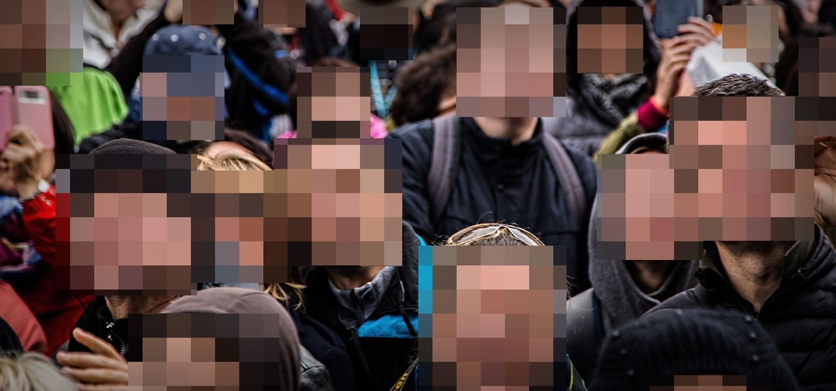
Novel Approach to IMAGE PRIVACY PRSERVATION Using Computer Vision Techniques
Faiyajuddin Shaik AP20110010363
Devalapalle Nikhith Reddy AP20110010368
Jagadeesh Pamulapati AP20110010386
Jayaprakash Kadiyala AP20110010403

Slide 2
Introduction
Our faces is also a part of our privacy, using that we can protect our mobile by face detection and find other missing people.
The vast data provided by machine learning algorithms are increasingly from the usage of users.
Out of all approaches face blurring is the most appropriate and effective techniques.
This technology allows us to share the data with other world while maintaining our privacy intact and others privacy like pictures and videos

Slide 3
IMPORTANCE
Protection of Identity: Preserving the privacy of individuals' faces helps protect their identity from unauthorized use or exposure.
Maintaining Confidentiality: Images and videos often contain sensitive information that should remain confidential, such as personal relationships, locations, or activities.
Compliance with Regulations: With the increasing focus on data privacy regulations such as GDPR and CCPA, organizations are under pressure to ensure the protection of users' personal information.

Slide 4
Applications
Media covering sensitive events
Medical Purposes : use of medical images for education and research
Social media
Insurance claims
Google maps: Street view

Slide 5
Methodology
Face obfuscation is developed mainly to reduce face photos privacy which concerns more.
For blurring the faces in videos, we use the recent technology of artificial intelligence.
There are many face blurring technologies based on Ai in which each of them differs a little bit.

Slide 6
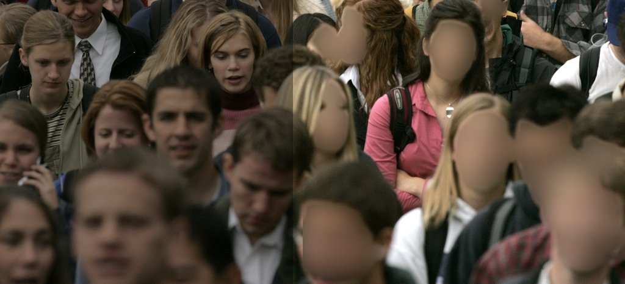
Blur Detection for Face Obfuscation
Face segmentation model to obscure sensitive picture portions using pixels
Face Blur's Effects on Computer Vision Tasks
Object identification, scene recognition, object detection, and face attribute categorization are a few examples of downstream computer vision tasks
As a result, even with faces obscured inside a car, the AI can still identify it.
This enables using facial blur to Create privacy-aware visual identification a workable technique.

Slide 7
Face Anonymization in Video Work
There are numerous methods which can apply to create face blur in videos.
One algorithms from these methods is used to detect and identify the face in that image, then that part is send to blurring filter.
Median Blur is one of the most popular face blurring methods.
Using the boundaries of images, the filter will blur the face edges and recognize who’s is whom.

Slide 8
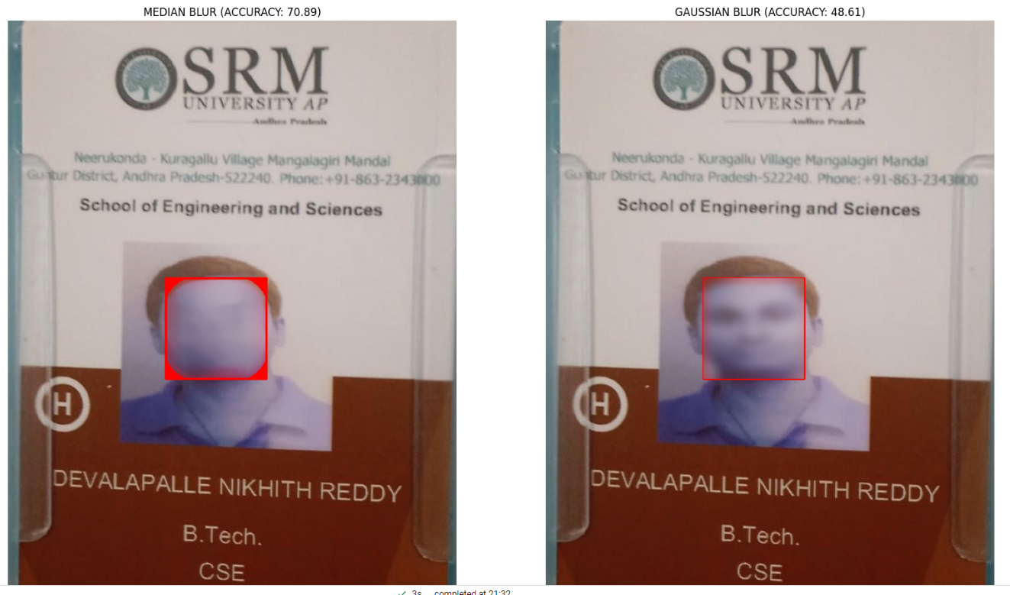
Blurring of face in an image

Slide 9
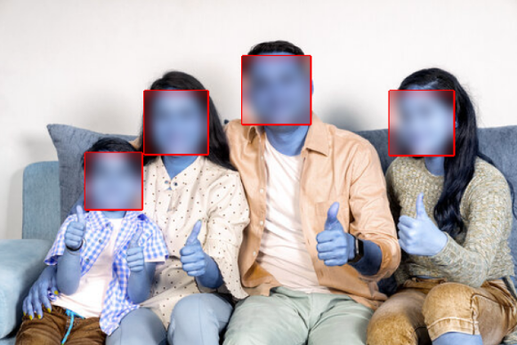
Multiple faces detection in an image

Slide 10
ALTERNATIVE METHODS TO ANONYMIZE FACES
1. Covering the face.
Examples of face-blurring-like face anonymization techniques include masking the facial area with occludes like mosaic or a black strip.
2. Face reconstruction
By replacing heads in photographs, a novel technique masks identities while maintaining a high degree of likeness to the content of the original image

Slide 11
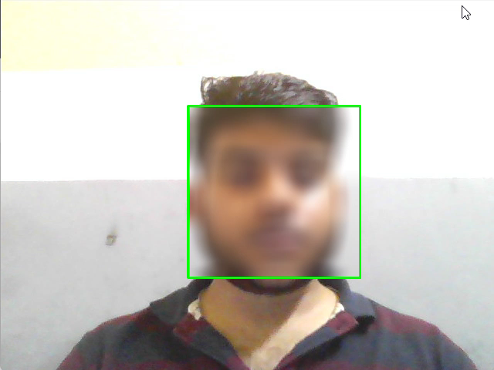
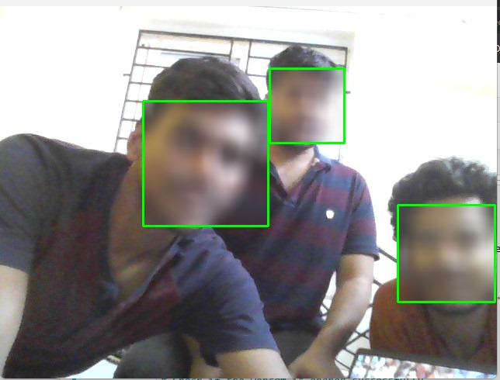
Video Blurring for live footage

Slide 12
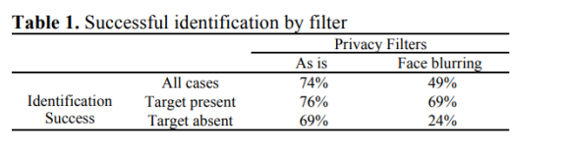
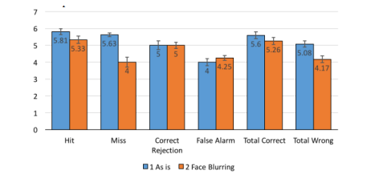

Slide 13
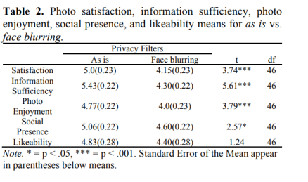
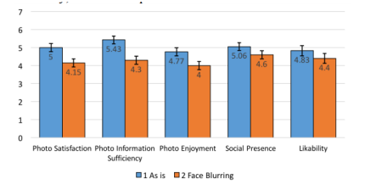

Slide 14
CONCLUSION
Growing concerns about privacy in digital imagery.
Utilization of face obfuscation and median blur techniques.
Balance between effectiveness and computational efficiency.Q
Quantitative metrics: detection accuracy, processing speed.
Subjective evaluations: impact on image clarity and aesthetics.
Practical and efficient solution for privacy concerns.
Applicable in social media, surveillance, and personal privacy tools.

Slide 15
THANK
YOU!

